Slide 1
Randomized Algorithms CS648
Lecture 20
Permutation routing on a hypercube
Distributed Leader Election

Slide 2
Routing on Hypercube
Recap from the last lecture

Slide 3


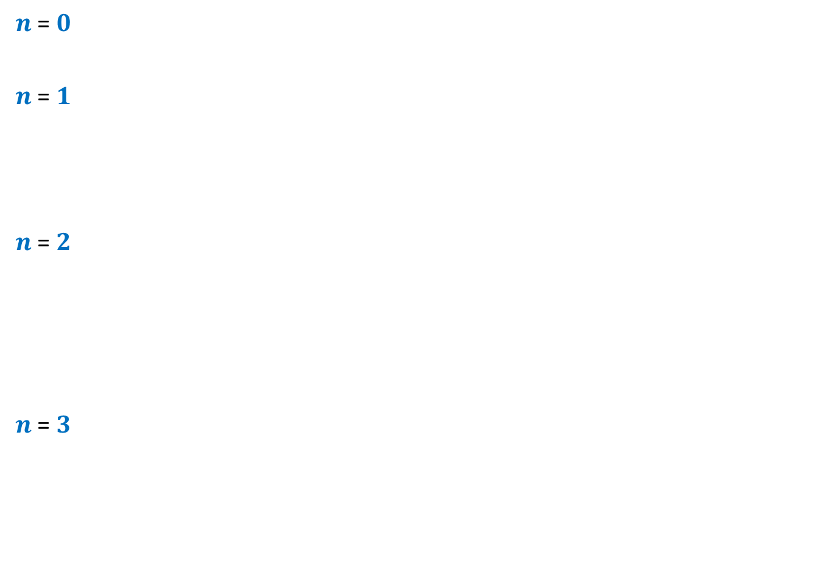













$n$-Hypercube
$n$ = $0$
$n$ = $1$
$n$ = $2$
$n$ = $3$
$$0$$
$$1$$
$$10$$
$$11$$
$$00$$
$$01$$
$$110$$
$$111$$
$$100$$
$$101$$
$$010$$
$$011$$
$$000$$
$$001$$

Slide 4



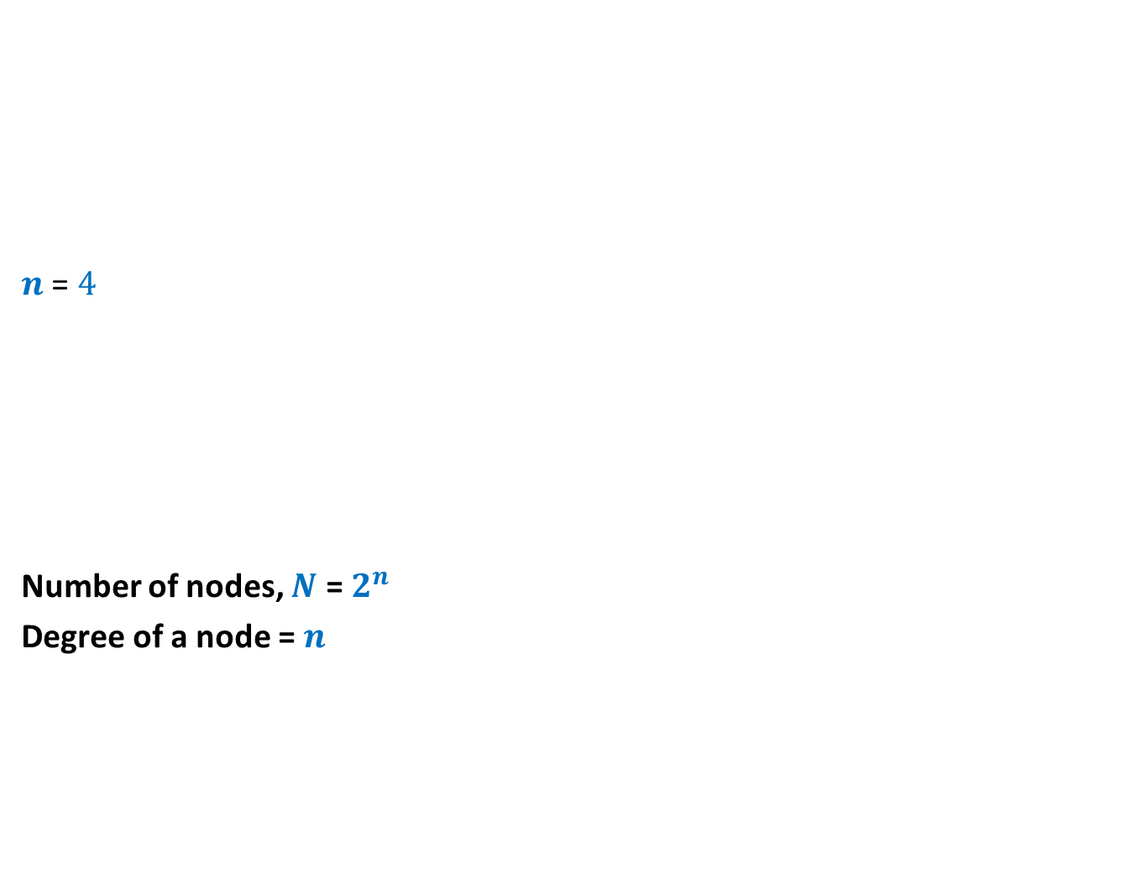













$n$-Hypercube
$n$ = $4$
Number of nodes, $N$ = $2^{n}$
Degree of a node = $n$
$$0110$$
$$0111$$
$$1110$$
$$1111$$
$$0100$$
$$0101$$
$$1100$$
$$1101$$
$$0010$$
$$0011$$
$$1010$$
$$1011$$
$$0000$$
$$0001$$
$$1000$$
$$1001$$

Slide 5
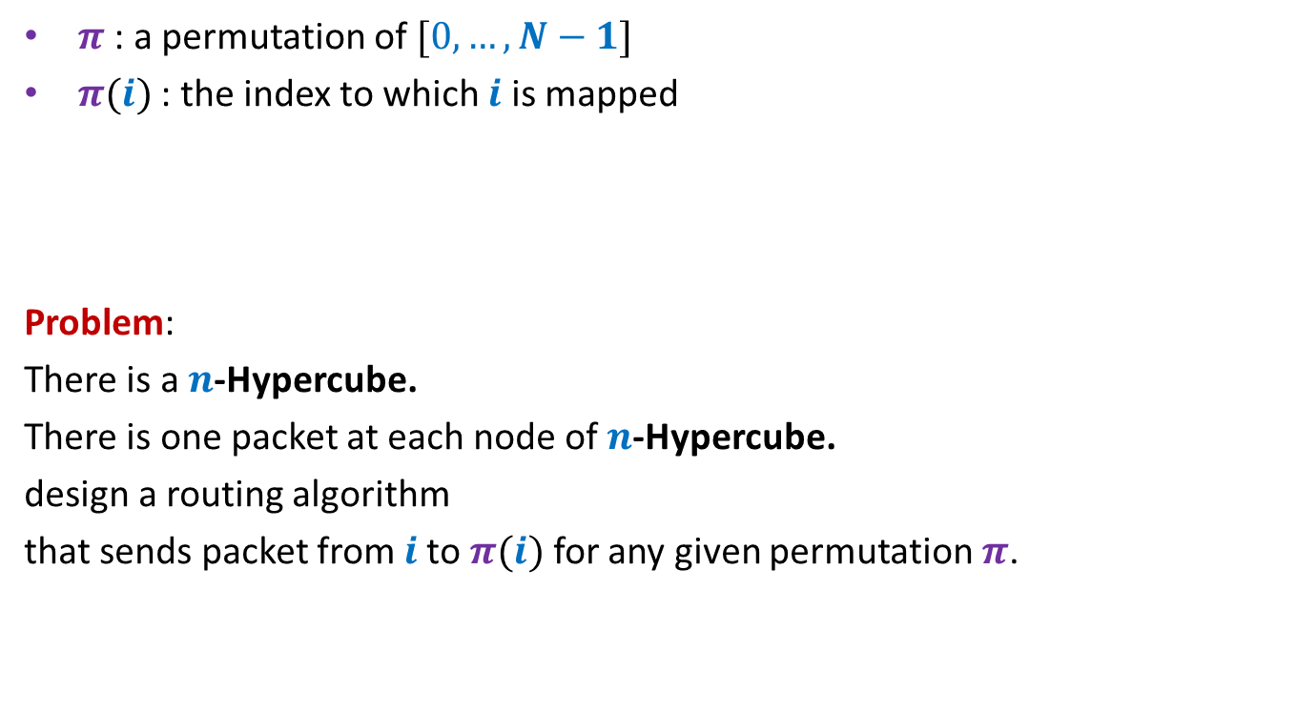

Permutation Routing on a $n$-Hypercube
$π$ : a permutation of $[0,…,N−1]$
$π(i)$ : the index to which $i$ is mapped
Problem:
There is a $n$-Hypercube.
There is one packet at each node of $n$-Hypercube.
design a routing algorithm
that sends packet from $i$to $π(i)$ for any given permutation $π$.

Slide 6
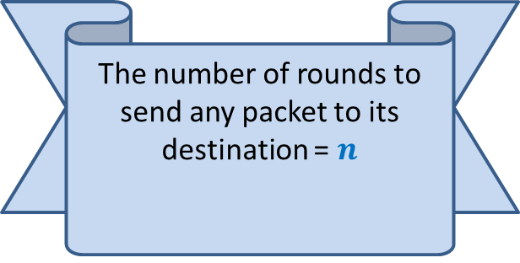
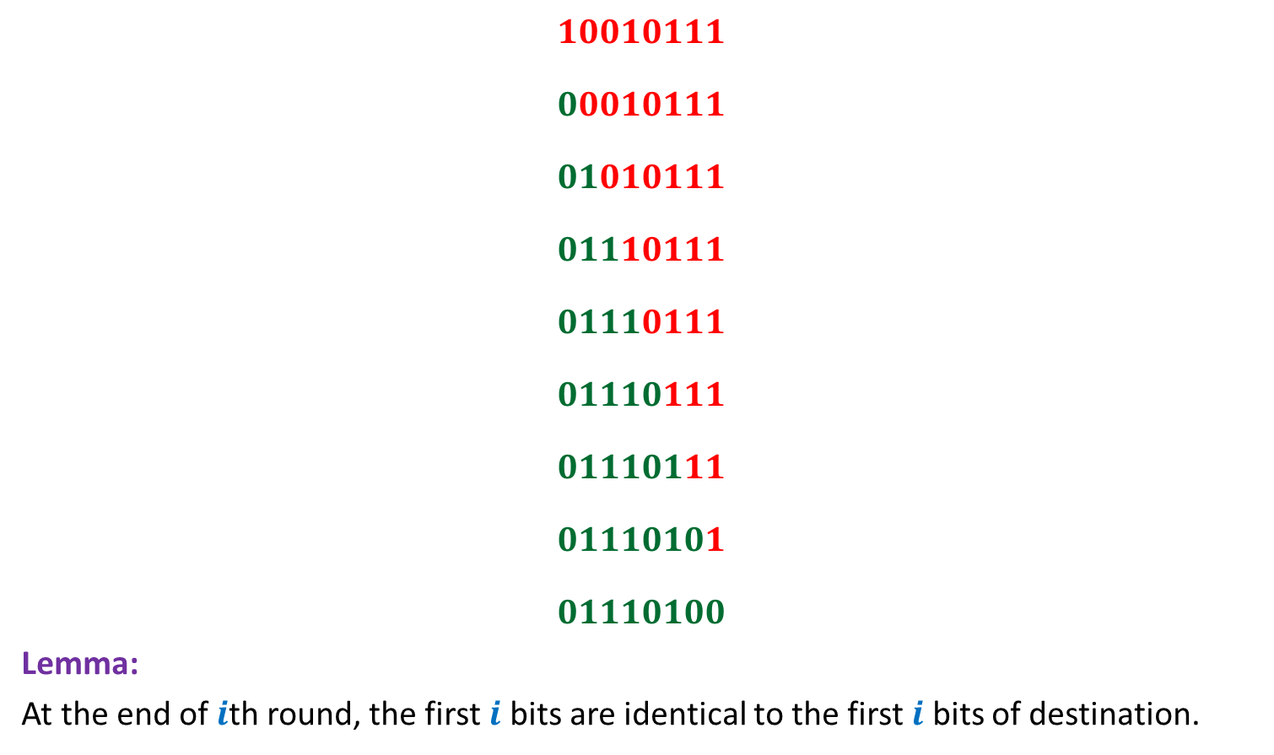
Bit-fixing algorithm
source
$$10010111$$
$$00010111$$
$$01010111$$
$$01110111$$
$$01110111$$
$$01110111$$
$$01110111$$
$$01110101$$
$$01110100$$
Lemma:
At the end of $i$th round, the first $i$ bits are identical to the first $i$ bits of destination.
The number of rounds to send any packet to its destination = $n$
No routing table needed
☺
(if there is no congestion
in the network)
destination

Slide 7
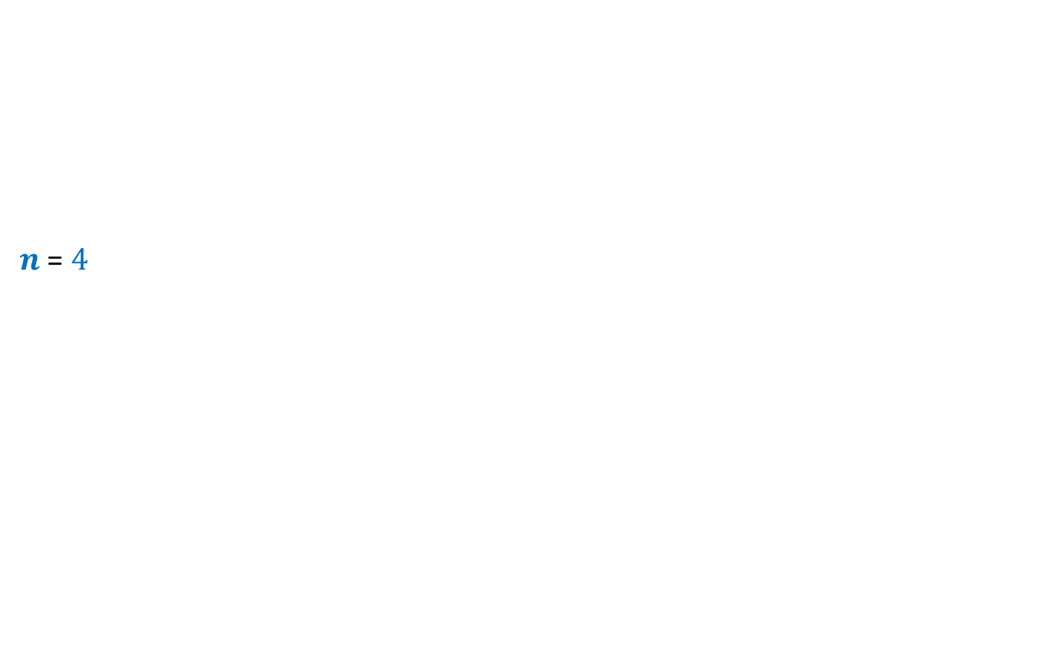
$n$-Hypercube
$n$ = $4$
$$0110$$
$$0111$$
$$1110$$
$$1111$$
$$0100$$
$$0101$$
$$1100$$
$$1101$$
$$0010$$
$$0011$$
$$1010$$
$$1011$$
destination
$$0000$$
$$0001$$
$$1000$$
$$1001$$
source

Slide 8







Worst case Permutation
source
$$a_{1},…{,a}_{\frac{n}{2}}$$
$$,b_{1},…{,b}_{\frac{n}{2}}$$
$$10010111$$
$$00010111$$
$$01010111$$
$$01110111$$
$$01110111$$
$$01111001$$
$$01111001$$
$$01111001$$
$$01111001$$
$N$ messages to pass through $\sqrt{N}$ nodes ➔At least $\frac{\sqrt{N}}{n}$ messages to pass through an edge
$$b_{1},…{,b}_{\frac{n}{2}}$$
$$, b_{1},…{,b}_{\frac{n}{2}}$$
$$b_{1},…{,b}_{\frac{n}{2}}$$
$$,a_{1},…{,a}_{\frac{n}{2}}$$
destination

Slide 9
How to use Randomization to avoid congestion?
Let us analyse a related problem

Slide 10
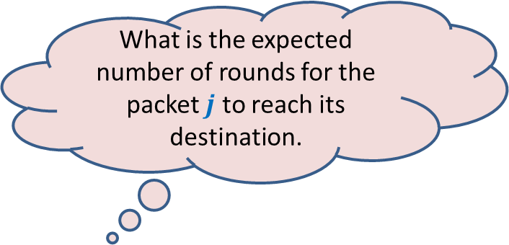

Send each packet to a uniformly random destination
For a packet originating from node $j$,
Pick a destination $r(j)$ randomly uniformly and independently
Send the packet to $r(j)$ using Bit-fixing algorithm
What is the expected number of rounds for the packet $j$ to reach its destination.

Slide 11

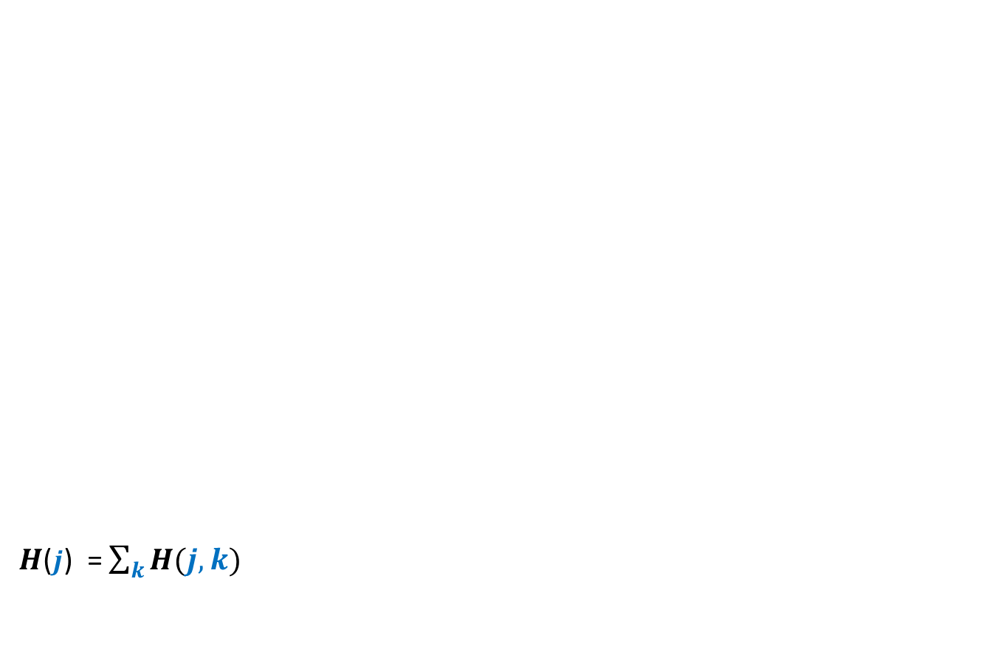

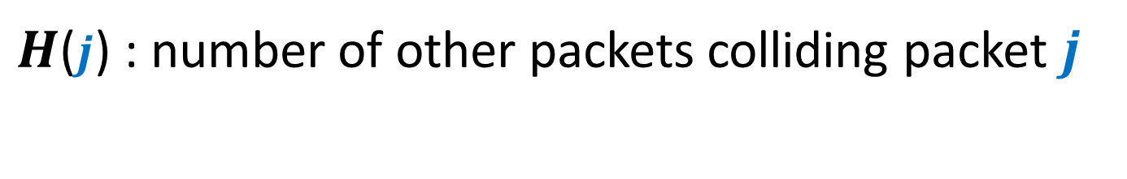
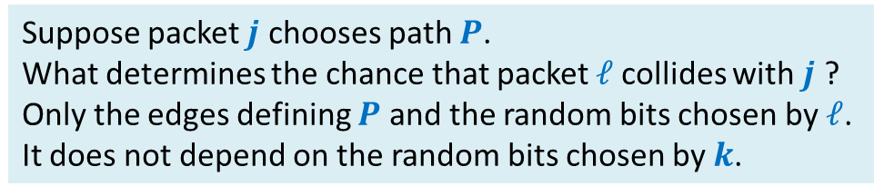



$H$($j$) : number of other packets colliding packet $j$
$$ℓ$$
source
$$j$$
$H$($j$) = $\sum_{k}{H(j,k)}$
Any relation between $H(j,k)$ and $H(j,ℓ)$ ?
$$P$$
$$k$$
They are independent ☺
Suppose packet $j$ chooses path $P$.
What determines the chance that packet $ℓ$collides with $j$ ?
Only the edges defining $P$ and the random bits chosen by $ℓ$.
It does not depend on the random bits chosen by $k$.
destination
$$H\left(j,k\right)=\left\{\begin{aligned} 1 if packet k collides with packet j \\ 0 if packet k does not collide with packet j \end{aligned}\right.$$

Slide 12



$H$($j$) : number of other packets colliding packet $j$
$$ℓ$$
source
$$j$$
$H$($j$) = $\sum_{k}{H(j,k)}$
What is E[$H(j,k)$]?
$$P$$
$$k$$
It seems difficult to compute E[$H\left(j,k\right)$] since the corresponding probability depends upon $j$as well as $k$.
So we take an alternate approach.
We focus on any path taken by packet $j$.
destination
$$H\left(j,k\right)=\left\{\begin{aligned} 1 if packet k collides with packet j \\ 0 if packet k does not collide with packet j \end{aligned}\right.$$

Slide 13



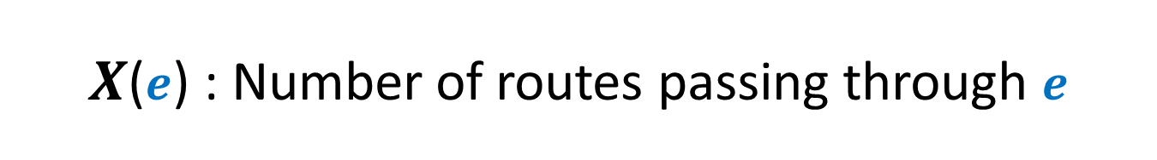


$X$($e$) : Number of routes passing through $e$
source
$$j$$
$$P$$
$$01010011$$
$$e$$
$$01000011$$
Focus on an edge of the path $P$.
destination

Slide 14



$X$($e$) : Number of routes passing through $e$
source
$$j$$
$$P$$
$$01010011$$
$$e$$
$$01000011$$
destination

Slide 15

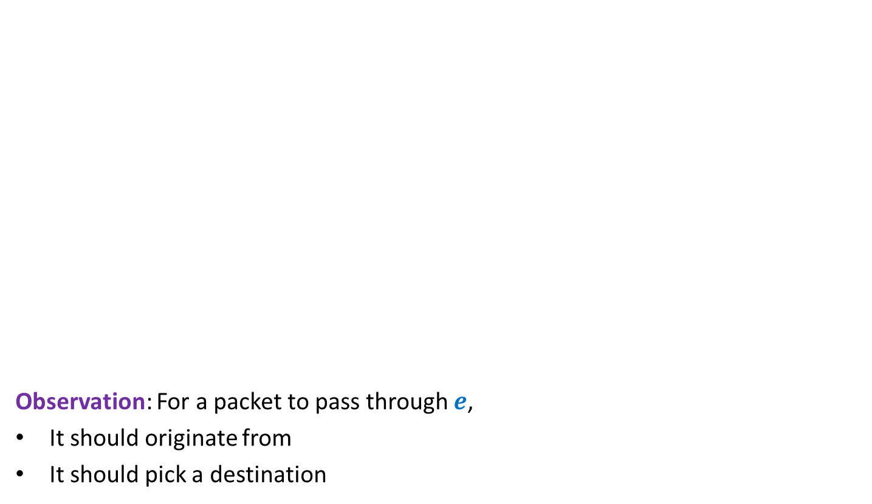






$X$($e$) : Number of routes passing through $e$
source
$$j$$
Observation: For a packet to pass through $e$,
It should originate from
It should pick a destination
$$P$$
$$d_{1}…d_{i−1}1 s_{i+1}…s_{n}$$
$$e$$
$$d_{1}…d_{i−1}0 s_{i+1}… s_{n}$$
$E[X(e)]$ $<\frac{1}{2}$
destination
$$∗∗∗∗∗1 s_{i+1}…s_{n}$$
No. of Packets = $2^{i−1}−1$
$$d_{1}…d_{i−1}0 ∗∗∗∗∗$$
Probability = $\frac{1}{2^{i}}$

Slide 16





$X$($e$) : Number of routes passing through $e$
source
$$j$$
Lemma: $E[\sum_{e∈P}{X(e)]}$ = ?
$$P$$
$$d_{1}…d_{i−1}1 s_{i+1}…s_{n}$$
Are $X(e)$’s independent ?
$$e$$
$$d_{1}…d_{i−1}0 s_{i+1}… s_{n}$$
$E[X(e)]$ = $\frac{1}{2}$
No
destination
$$\frac{|P|}{2}$$
$$≤\frac{n}{2}$$

Slide 17


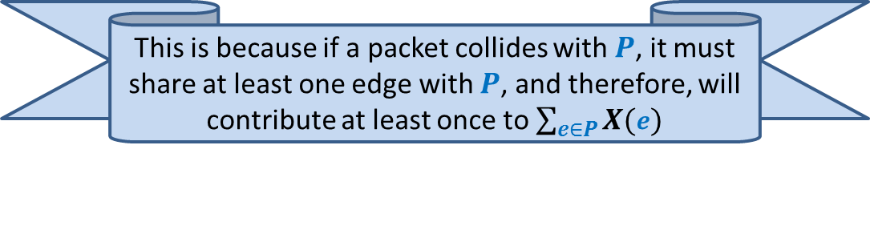
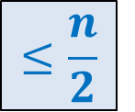
$H$($j$) : number of other packets colliding packet $j$
Question:
For any path $P$,
what is the relation between $H$($j$) and $\sum_{e∈P}{X(e)}$
$H$($j$) $≤ \sum_{e∈P}{X(e)}$
Lemma: Expected value of $H$($j$) = ?
$$≤\frac{n}{2}$$
This is because if a packet collides with $P$, it must share at least one edge with $P$, and therefore, will contribute at least once to $\sum_{e∈P}{X(e)}$

Slide 18


source
$$j$$
Answer: $\left|P\right|+ℓ$
$$P$$
destination
Contiguity ?

Slide 19



source
$$j$$
$$01010111$$
$$P$$
$$01010011$$
$$01000011$$
destination

Slide 20


source
$$j$$
Answer: $\left|P\right|+ℓ$
$$01010111$$
$$P$$
$$01010011$$
$$01000011$$
destination

Slide 21
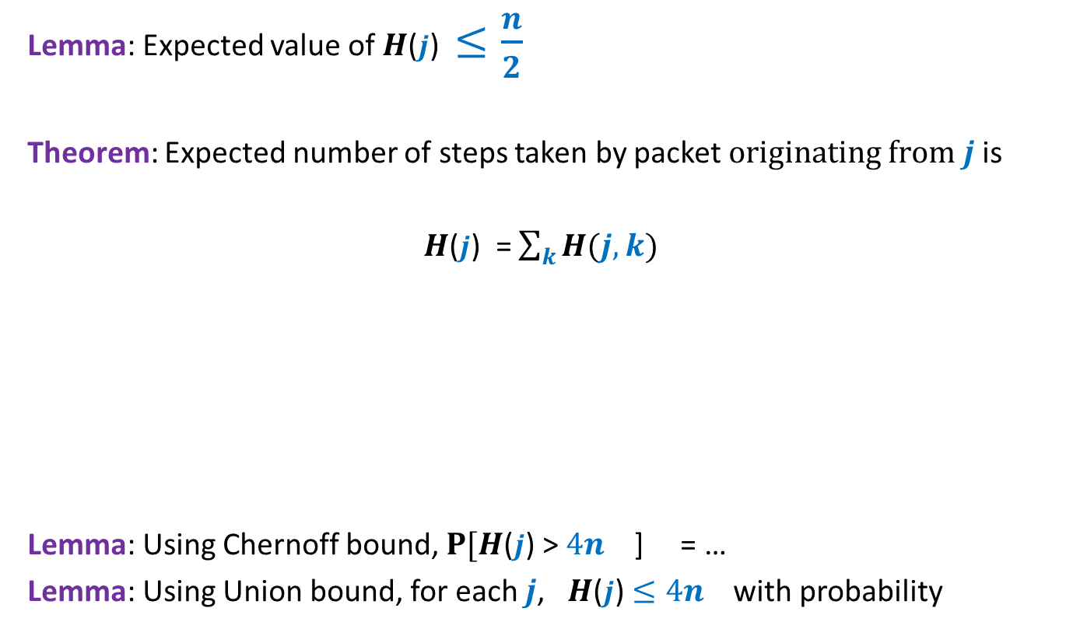

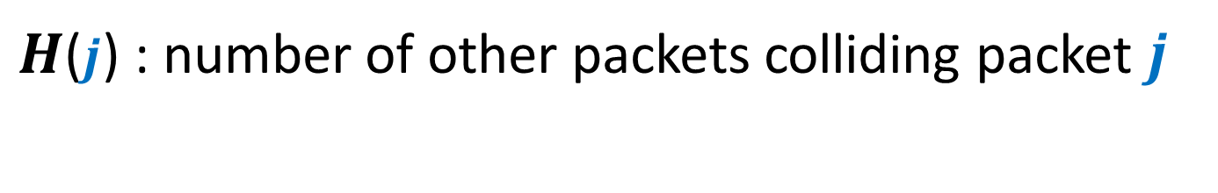
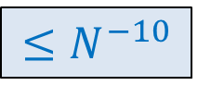

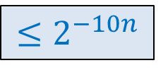

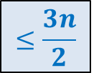
$H$($j$) : number of other packets colliding packet $j$
Lemma: Expected value of $H$($j$) $≤\frac{n}{2}$
Theorem: Expected number of steps taken by packet $originating from j$ is
$H$($j$) = $\sum_{k}{H(j,k)}$
Lemma: Using Chernoff bound, $P[H$($j$) > $4n$ ] = …
Lemma: Using Union bound, for each $j$, $H$($j$) $≤4n$ with probability
$$≤\frac{3n}{2}$$
$$H\left(j,k\right)=\left\{\begin{aligned} 1 if packet originating from k collides with j \\ 0 if packet originating from k does not collide with j\end{aligned}\right.$$
$${≤2}^{−10n}$$
$$6n$$
$${≤N}^{−10}$$
$$6n$$
$${≥1−N}^{−9}$$

Slide 22
How to design an efficient Algorithm for Permutation Routing ?
You will be amazed to see the algorithm.
This algorithm is inspired by the analysis for
Routing for Random destination
that we carried out recently.

Slide 23
How to design an efficient Algorithm for Permutation Routing ?

Slide 24
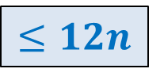
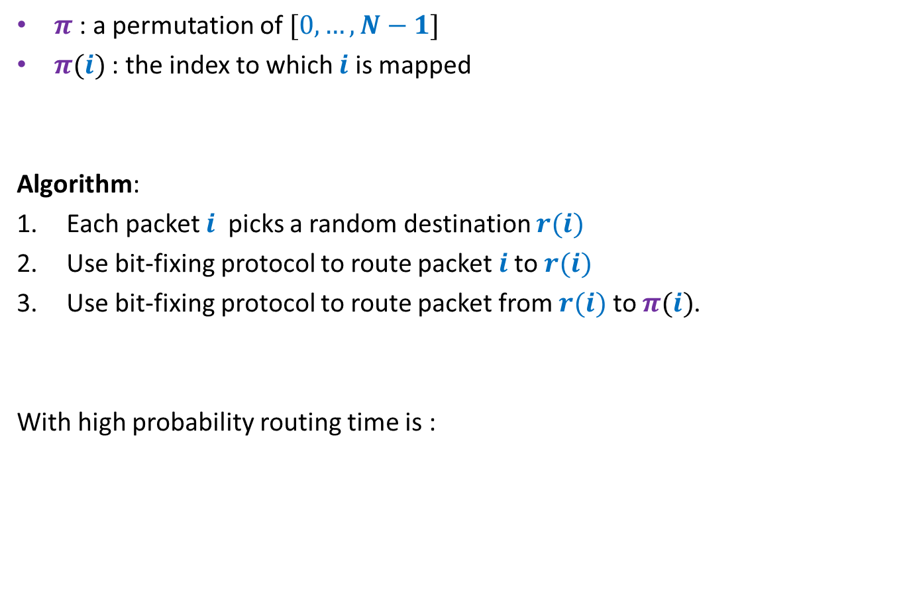
Algorithm
$π$ : a permutation of $[0,…,N−1]$
$π(i)$ : the index to which $i$ is mapped
Algorithm:
Each packet $i$ picks a random destination $r(i)$
Use bit-fixing protocol to route packet $i$to $r(i)$
Use bit-fixing protocol to route packet from $r(i)$ to $π(i)$.
With high probability routing time is :
$$≤12n$$

Slide 25
Birthday Paradox
Leader Election in
Distributed Environment

Slide 26
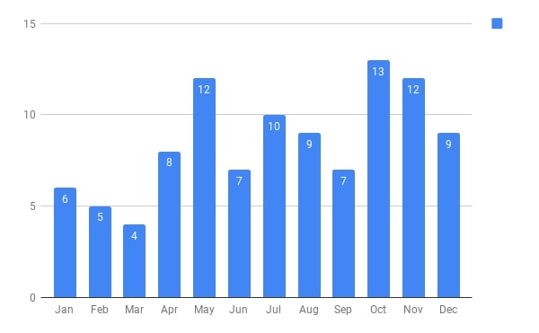
Birthdays of students who were present in the 1st class of CS203B taught in 2018
There are 102 students and 365 days.
What might be the chances of two students sharing a birthday ?

Slide 27



















































First 25 students
First 50 students
First 75 students
All 102 students
$$2$$
$$7$$
$$11$$
$$31$$
$$≈28$$
$$2$$
$9$^{th} January
$$3$$
$5$^{th} May
$$2$$
$27$^{th} July
$$2$$
$9$^{th} January
$$2$$
$9$^{th} January
$$2$$
$3$^{rd} June
$$3$$
$27$^{th} July
$$3$$
$27$^{th} July
$$2$$
$7$^{th} July
$$3$$
$27$^{th} July
$$2$$
$7$^{th} October
$$2$$
$2$^{th} October
$$2$$
$2$^{th} October
$$2$$
$7$^{th} October
$$2$$
$22$^{th} October
Can we explain this ?
$7$^{th} October
$$2$$
$8$^{th} December
$$3$$
$$2$$
$26$^{th} October
$$2$$
$1$^{st} November
$$2$$
$4$^{th} November
Yes, using a model studied multiple times in this course
$$2$$
$14$^{st} November
$$2$$
$10$^{th} December
Prob.>$0.5$
Prob.>$0.97$
Prob.>$0.9997$
Prob.>$0.9999997$

Slide 28
Balls into BINS

Slide 29

Balls into Bins
1 2 3 4 5 … $j−1$ $j$
Ball-bin Experiment: There are $j$ balls and $n$ bins.
Each ball selects its bin randomly uniformly and independent of other balls
and falls into it.
1 2 3 … $i$ … $n$

Slide 30
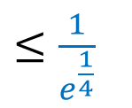
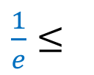


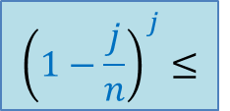

Balls into Bins
1 2 3 4 5 … $j−1 j$
Question : What is the probability that no bin has more than one ball ?
$$1⋅\left(1−\frac{1}{n}\right)⋅\left(1−\frac{2}{n}\right)⋅⋅⋅\left(1−\frac{j−1}{n}\right)$$
1 2 3 … $i$ … $n$
For $j=\sqrt{n}$
$${\left(1−\frac{j}{n}\right)}^{j}≤$$
$${≤\left(1−\frac{j}{2n}\right)}^{\frac{j}{2}}$$
$\frac{1}{e}≤$
$≤\frac{1}{e^{\frac{1}{4}}}$

Slide 31

Balls into Bins
1 2 3 4 5 … $j−1 j$
$A:$ ``no bin has more than one ball’’
Observations :
If $j≈\sqrt{n}$ , Pr[$A$] is a constant
If $j≈Ω(\sqrt{n}\log{n})$, Pr[$A$] is inverse polynomial
1 2 3 … $i$ … $n$

Slide 32
Leader Election
Distributed environment

Slide 33


Leader Election in a complete network
Implicit
There are $n$ nodes.
Each node is connected to every other node.
Each node
knows $n$.
can send a message to its neighbours.
can do local computation.
A single node : “leader”
Every other node is a slave
Every node knows the leader
$$n=5$$
Find a leader

Slide 34
Leader Election in a complete network
Implicit
There are $n$ nodes.
Each node is connected to every other node.
Each node
knows $n$.
can send a message to its neighbours.
can do local computation.
A single node : “leader”
Every other node is a slave
Only leader knows that he/she is leader
$$n=5$$
Find a leader

Slide 35

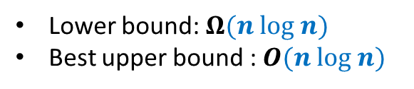
Leader Election in a complete network
Implicit
Assumption: Suppose each node has a unique id.
Complexity of Trivial algorithm:
One round
$n(n−1)$ messages
Trivial algorithm:
Each node broadcasts its id.
The node with highest id is the leader.
Can you use this assumption as a hint to design an algorithm ?
$$n=5$$
Find a leader
Deterministic algorithms
Lower bound: $Ω(n log n)$
Best upper bound : $O(n log n)$

Slide 36










What can randomization offer ?
$$T$$
$$T$$
$$H$$
$$T$$
$$H$$
$$T$$
$$H$$
$$T$$
$$T$$
$$T$$

Slide 37












What can randomization offer ?
$$T$$
$$T$$
$$H$$
$$T$$
. . . .
$$H$$
$$T$$
$$T$$
$$H$$
$$T$$
$$T$$

Slide 38
What can randomization offer ?
. . . .

Slide 39

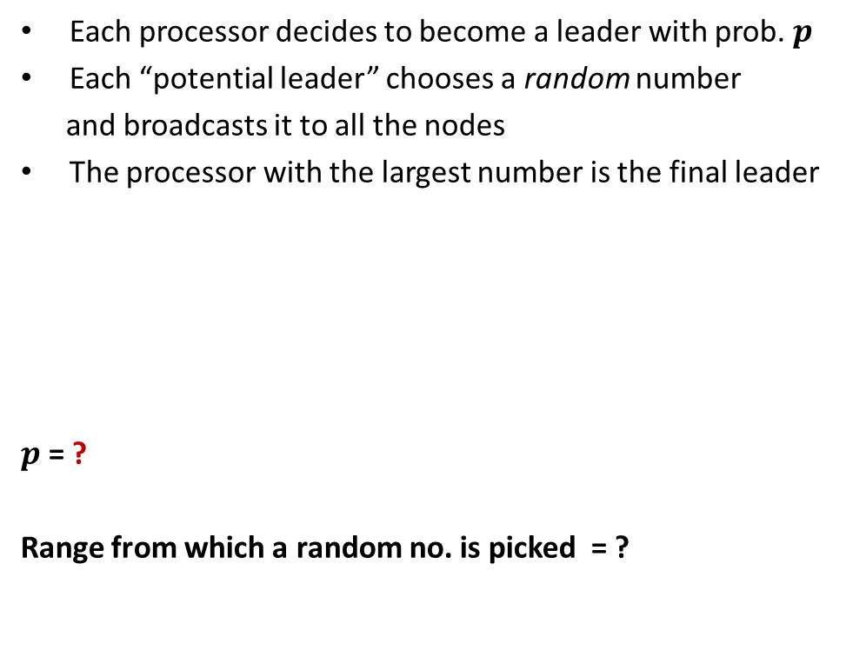
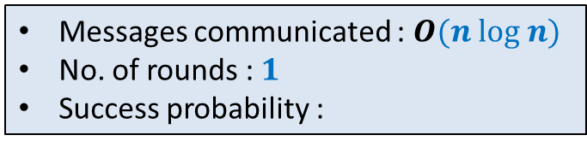

Each processor decides to become a leader with prob. $p$
Each “potential leader” chooses a random number
and broadcasts it to all the nodes
The processor with the largest number is the final leader
$p$ = ?
Range from which a random no. is picked = ?
To Ensure that there is at least one potential leader with high probability.
$$\frac{3\left(log n\right)}{n}$$
To ensure that no two potential leaders pick the same random number with high probability.
$$[1,n^{4}]$$
Messages communicated : $O(n log n)$
No. of rounds : $1$
Success probability :

